Slide 1
Cartilage and bone histology
Dr Hemed Elbusaidy

Slide 2
Objectives
Types of cartilage
Distribution & functions of cartilage
Universal properties of each type
Disorders of cartilage

Slide 3
Types of cartilage
Hyaline
Fibrocartilage
Elastic cartilage

Slide 4
Hyaline cartilage
Distribution:
Costal cartilage
Large airways
Articular cartilage
Epiphyseal growth plate
Functions:
Support/resilience
Shock absorption
Protection
Cell types: chondroblast, chondrocyte, chondoclast
Collagen type: col I

Slide 5
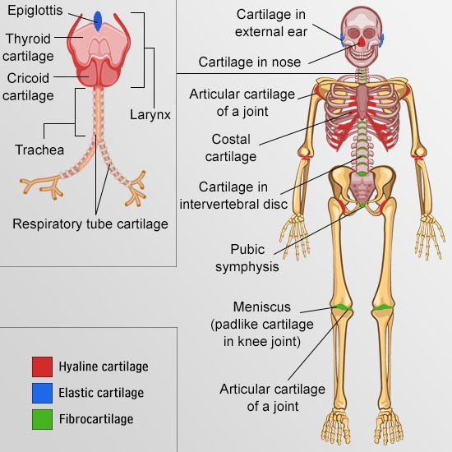
Cartilages of the body

Slide 6
Universal properties of hyaline
Avascular
Perichondrium (absent in articular cartilage)- wear and tear
Functions of perichondrium:
Support/maintainance
Source of new cells after trauma
Harbors vessels, nerves and lymphatics

Slide 7
Identification points for hyaline
Homogenous
Basophilic matrix
Cells in lacunae
Chondrocytes in isogenous groups
Glassy appearance

Slide 8
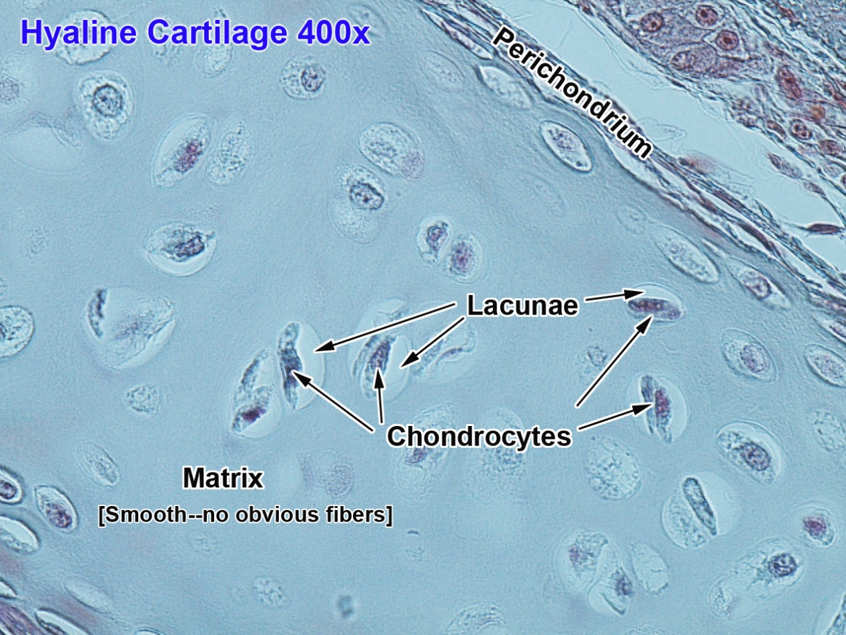
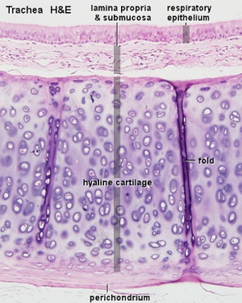

Slide 9
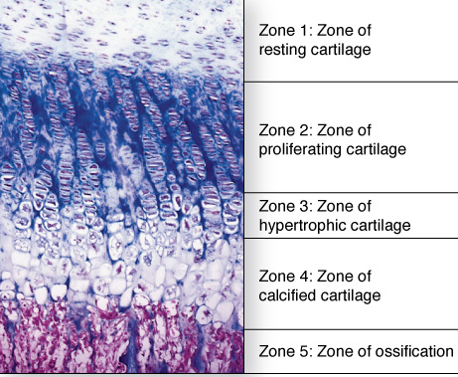
The epiphyseal growth plate

Slide 10
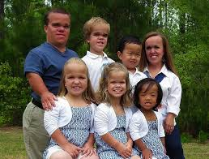
Disorders of cartilage
Achondroplasia
Reason: mutation of FGF 3

Slide 11
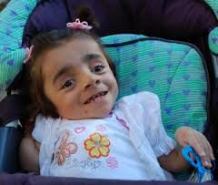
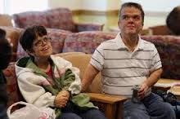
Other disorders of collagen & cartilage
Collagen type | Disorder
Col I | Osteogenesis imperfecta
Col III | Ehler Danlos syndrome
Col IV (Basement membrane) | Alports syndrome
Col IX | Multiple epiphyseal dysplasia
Multiple collagen types | Scurvy
Osteogenesis imperfecta
Multiple epiphyseal dysplasia

Slide 12
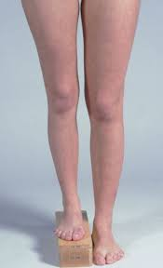
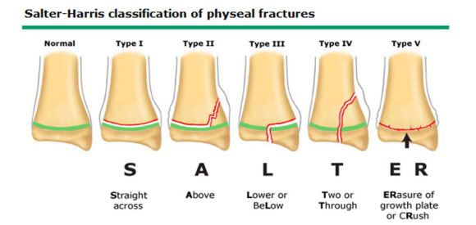
Disorder of growth plate (salter harris fracture)

Slide 13
fibrocartilage

Slide 14
Universal characteristics
Lacks perichondrium
Chondrocytes not in isogenous groups
Acidophilic matrix
Parrarel arrangement of collagen fibers
Relatively acellular
Functions:
load bearing
Protection
Shock absorption
Unique: fibrocartilage (unlike hyaline) has more fibers than cells

Slide 15
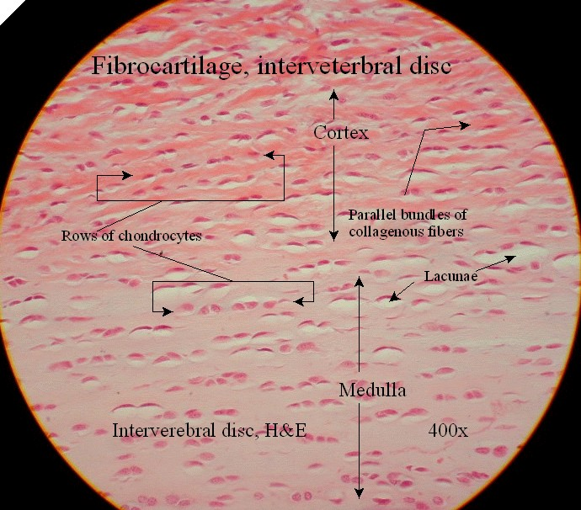
Fibrocartilage

Slide 16
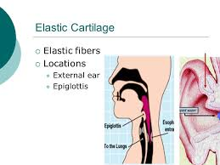
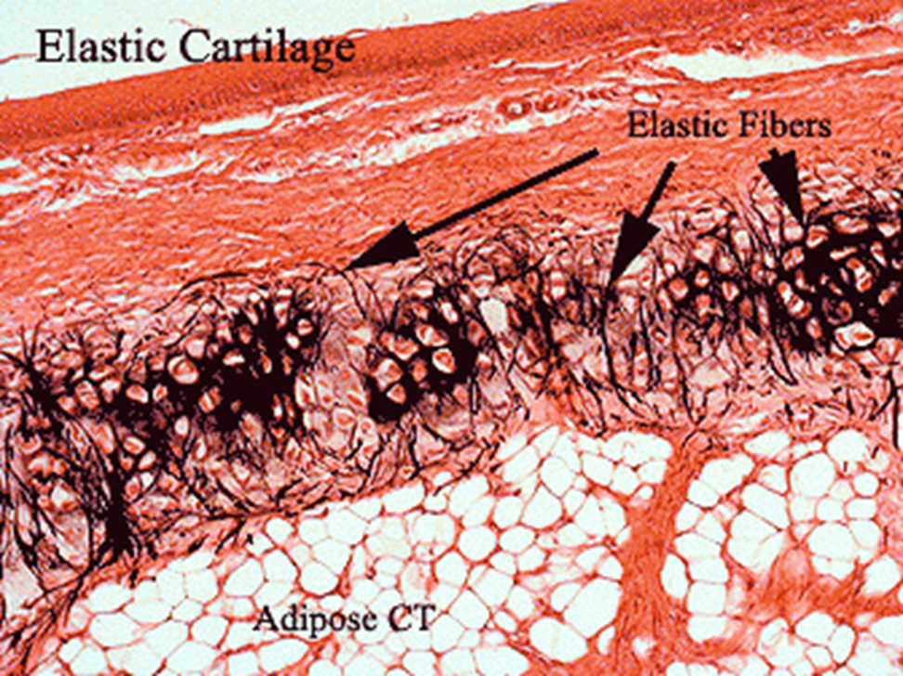
Elastic cartilage

Slide 17
Bone histology- objectives
Parts of a long bone
Histological components of bone
Unique features of bone
Cell types in bone
Growth/ossification of bone
Disorders of bone

Slide 18
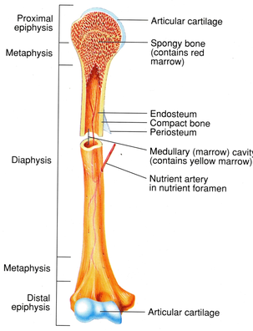
Parts of a long bone

Slide 19
Histological components of bone
Cells: osteoblasts, osteocytes, osteoclasts
Matrix: fibers and ground substance
Fibers: col I
ground substance: chondroitin sulphate, keratan sulphate and hyaluronic acid
Sources of blood supply to long bone:
Muscle attachment
Periosteum
Nutrient foramen
Diffusion from synovial fluid

Slide 20
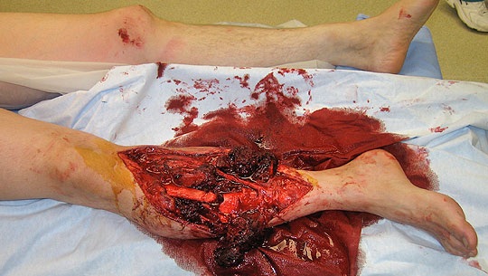
Open tibia fracture (periosteum broken)

Slide 21
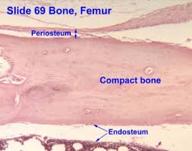
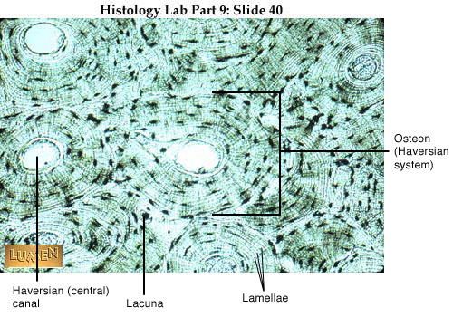
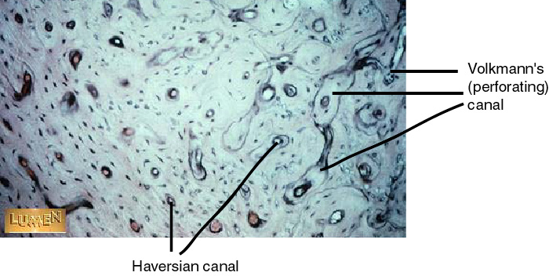
Unique features of bone

Slide 22
Phases of osteocytes
Resting phase
Formative/synthetic phase
Resorptive phase
Types of Ossification of bone:
Intramembranous (occurs in mesenchyme)
Endochondral (occurs in pre-existing cartilage)

Slide 23
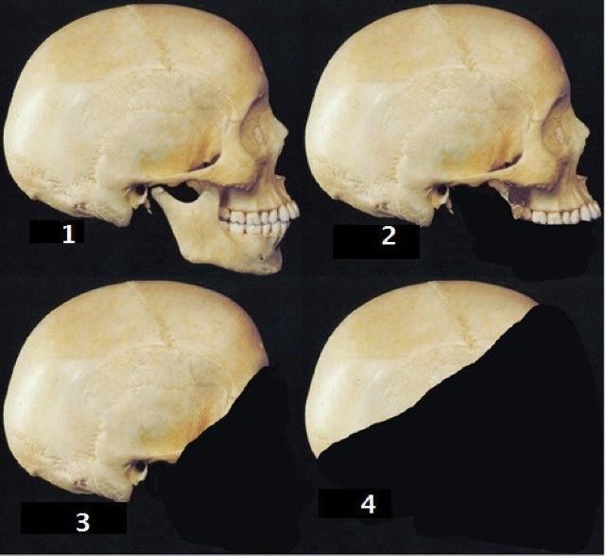
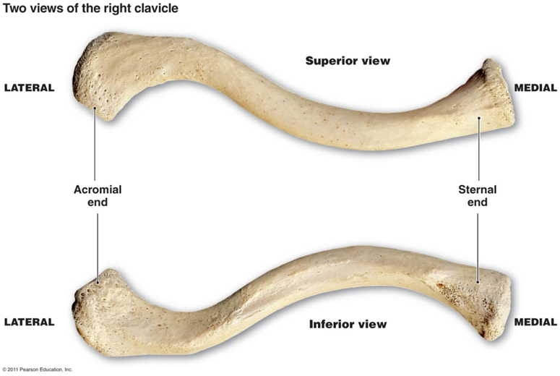
I. Intramembranous Ossification
End goal: Production of flat bones of skull and most of the clavicle.

Slide 24
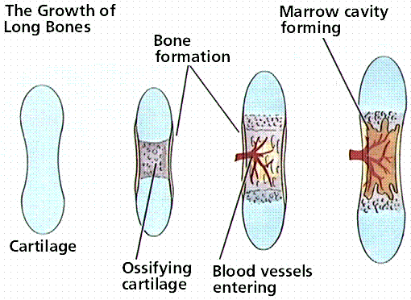
Endochondral method

Slide 25
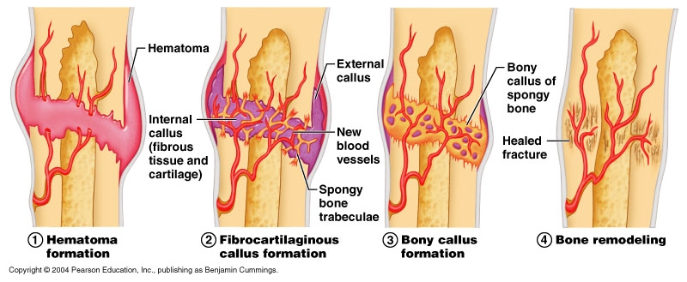
Phases of fracture healing

Slide 26
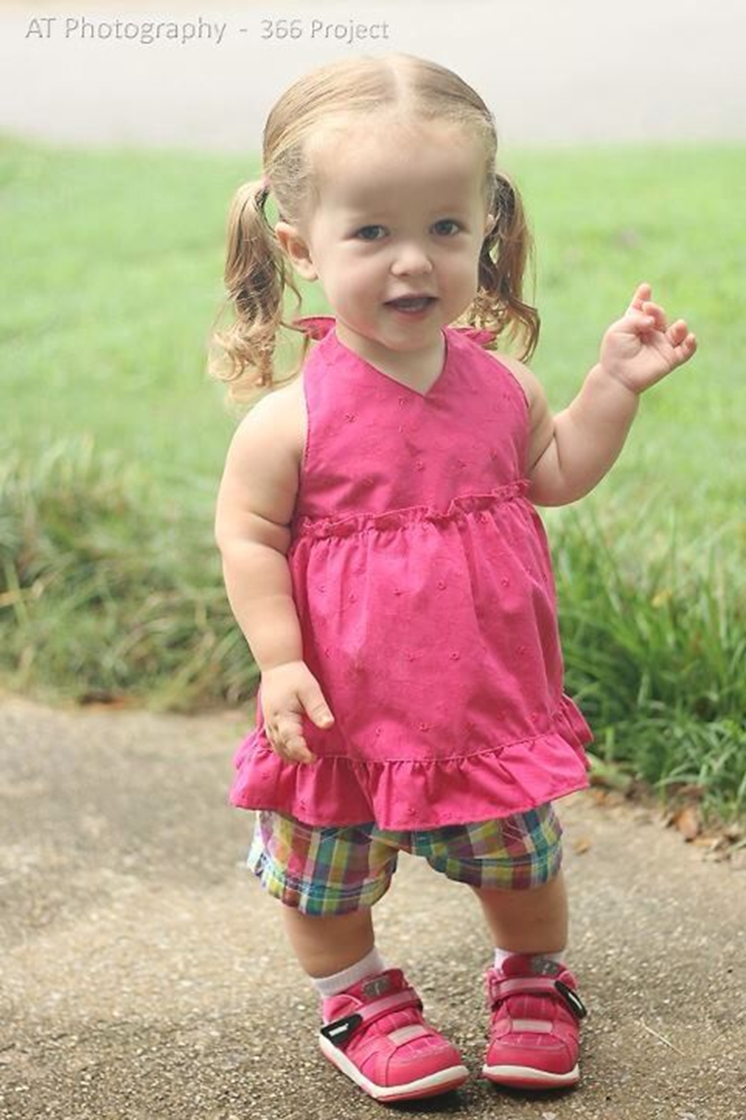
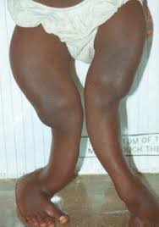
Disorders of bone
Rickets
Achondroplasia

Slide 27
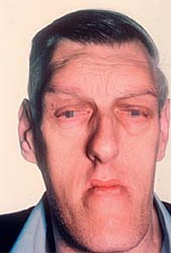
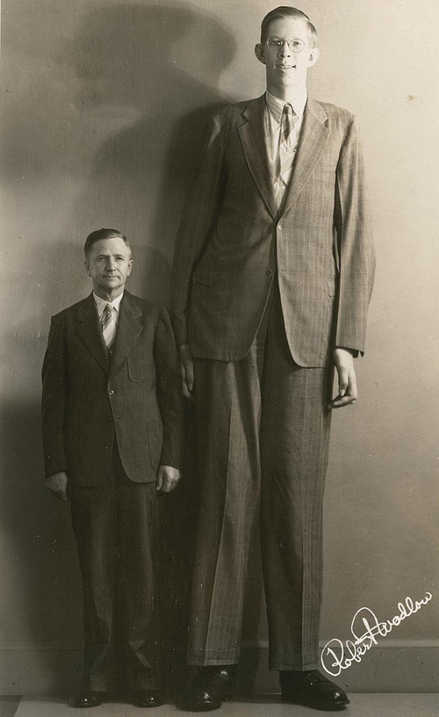
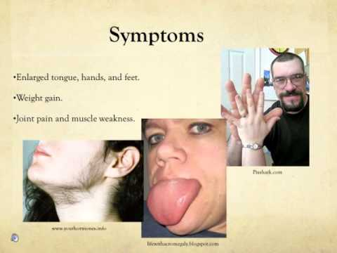

Slide 28
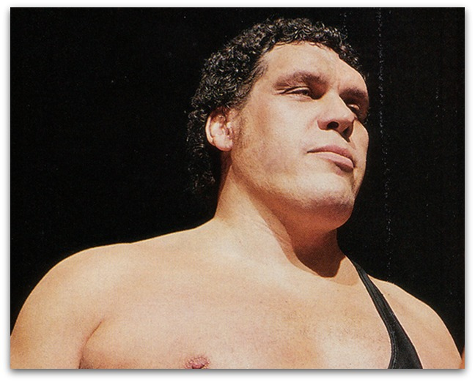

Slide 29
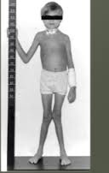
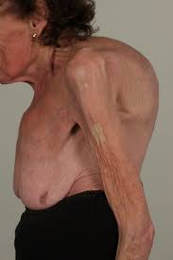
Renal osteodystrophy
Severe Osteoporosis

Slide 30
The end
Thank you

